Slide 1
Trapdoor Functions, Large Numbers and Factoring
Keeping your personal information secure

Slide 2
Trapdoor functions
https://www.youtube.com/watch?v=YEBfamv-_do
(To 4:30)

Slide 3
Factoring!
Find the factors of 12
Find the factors of 51
Find the factors of 221
How might you find the factors of:
671998030559713968361666935769

Slide 4
BIG Numbers
That last number is 30 digits long
How big is that?
Let’s start with something small, like 1,000,000 (7 digits)
How long was 1,000,000 seconds ago?

Slide 5
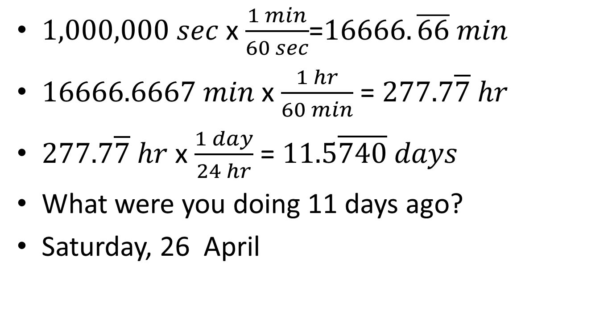
BIG numbers
$1,000,000 sec$ x$\frac{1 min}{60 sec}$=$16666.\overline{66} min$
$16666.6667 min$ x $\frac{1 hr}{60 min}$ = $277.7\overline{7} hr$
$277.7\overline{7} hr$ x $\frac{1 day}{24 hr}$ = $11.5\overline{740} days$
What were you doing 11 days ago?
Saturday, 26 April

Slide 6
BIGGER Numbers
What about 1,000,000,000 seconds ago?
(10 digits)
1 bill = 1,000 x 1 mill
So about 11 x 1,000=11,000 days?
If 1 year is about 400 days (close to 365), then this is about 12,000/400=30 years.
Calculations show that 1,000,000,000 sec is 31.7 years.

Slide 7
AND EVEN BIGGER
Like the game 2048, we have the game:
9007199254740992 (16 digits)
http://www.csie.ntu.edu.tw/~b01902112/9007199254740992/
At 1000 moves per second this would take:
90,000 years!

Slide 8
Trapdoor (one way) Functions
Why does factoring make a good one way function?
Generally you have to check up to the square root of a number for factors. Why?
Why would they use 100 digit primes in secret codes?

